Slide 1
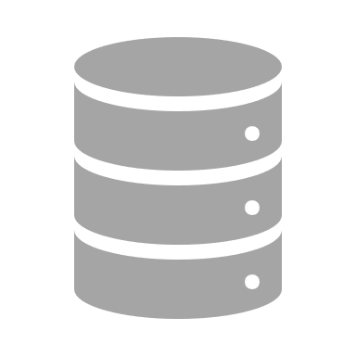
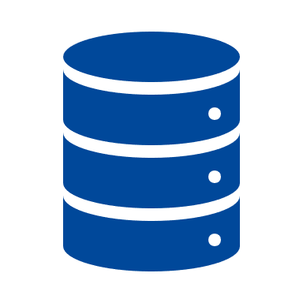
As Much as Necessary, as Little as Possible – Effective Test Data Reduction via Time Slice and Data Selection
Updates, transformation processes and security require flexible access to up-to-date test data. For many companies, this raises the question of costs and the time involved in creating the test data – two factors that are often associated with regular data updates.
SNP Test Data Organizer solves both these challenges with a single function: selective client copy. The time slice allows you to reduce the data volume in the test system according to your company-specific requirements in just one click. For test systems, it is often sufficient to use only the data from the most recent fiscal years or specific business units. You decide which data you need for your individual test case. You create your test case using over 1,000 individual components or you simply choose from our numerous templates. This provides the following advantages:
The data volume in the test system is reduced by up to 80%
The migration period is shortened by up to 75% (under optimal conditions)
The internal workload is reduced through automation
Thanks to the synchronous transfer to multiple test systems and the data reduction, test systems are filled more quickly. From now on, you can spend less time on organization and moretime on what is actually important: regularly updating yourtest data.
Example: Client Copy in an Oracle Database
A company wants to build a new development environment for product testing. The planned test cases do not require a complete system copy, as the developers only need the data from organizational unit C and from the past two years. The criteria are entered into SNP Test Data Organizer, and the application data volume is reduced during the data transfer:
Step 1
Selection: Data reduction criteria
Organizational units
Data history
A
B
C
2021
2020
2019
[…]
Step 2
Implementation: Data transfer
“Because SNP Test Data Organizer is easy to use, we can now support DevOps in our company much more flexibly. We can retrieve the data we currently need at any given time, rather than waiting months for a new system copy.”
Production system
(2 billion records)
1 TB
7 hours
Customer, int. mechanical engineering group
Test system
200 GB
Day 1
Day 2
Day 3

